Slide 1
LUNG CANCER IMAGING TOOL
A tool for medical image processing and cancer segmentation on lung-ct images
MEDICAL IMAGING
2021
Marco Peracchi- X
Federico De Servi - 812166

Slide 2
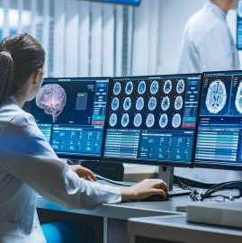
Topics
1) INTRODUCTION
2) IMAGE VISUALIZATION TOOL
3) IMAGE SEGMENTATION TOOL
4) CLUSTERING AND CLASSIFICATION
4) DEMO

Slide 3
INTRODUCTION

Slide 4

Lung cancer
The objective is to train a CNN model in order to classify correctly the biggest number of audio containing sounds of animals. These sounds have a lenght that ranges from 2 to 3.5 seconds and different levels of background noise.

Slide 5

Dataset
The audio dataset has been downloaded from the Animal Sound Archive made available by the Museum für Naturkunde Berlin through the Gbif website. It is composed of audios whose lenght is variable. The audios has been manually cut in order to isolate the sound (3.5 sec max).
Moose
Buffalo
Chimpanzee
Deer
Fox
Horse
Lion
Otter
Racoon
Sheep

Slide 6
Image visualization tool

Slide 7
Image SEGMENTATION tool

Slide 8
CLUSTERING AND CLASSIFICATION

Slide 9
DEMO

Slide 10
Modelling
ResNet101
Dropout(0.5)
ReLU()
BatchNormalization()
Dense(200, activation='relu', kernel_regularizer=regularizers.l2(l2=0.0005))
Dropout(0.5)
ReLU()
BatchNormalization()
Dense(10, activation='softmax')
Since the problem is unbalanced, we calculated the first thing to do is to calculate the weights for each of the 10 classes, and to use them during training. Various models has been tried, ranging from simple CNN models to complex image recognition models.
After many trials, this model resulted to be the best. It uses ResNet101 with imagenet weights, followed by a block made of Dropout + ReLu activation function + BatchNormalization layer. Then, a Dense layer with 200 units and l2 weight regularization and another block of Dropout + ReLu activation function + BatchNormalization layer follow. In the end, a Dense layer with 10 units and softmax activation function is added as final layer.
+
+
+
+
+
+
+
+

Slide 11
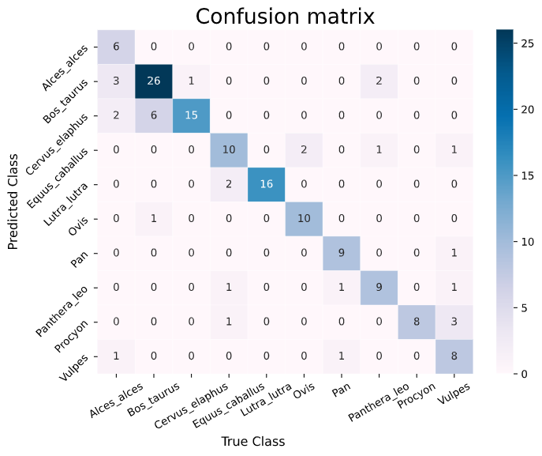
Results
Test accuracy
0.79

Slide 12
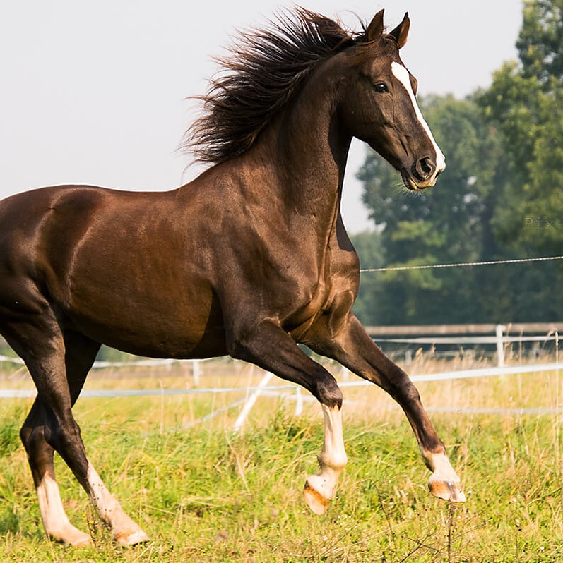
Preprocessing
First of all, the Resnet preprocessing function is applied. After doing that, data augmentation techniques, like zooming, flipping horizontally, rotating, shifting and changing the brightness are applied to the images. Then, the images are imported as 224x224x3 rgb images and fed them to the model.

Slide 13
Objective
The goal of the Image Retrival task is to select the 9 most similar animal images based on a query one. In particular, this tool would perform on real animals images and picture ones.

Slide 14
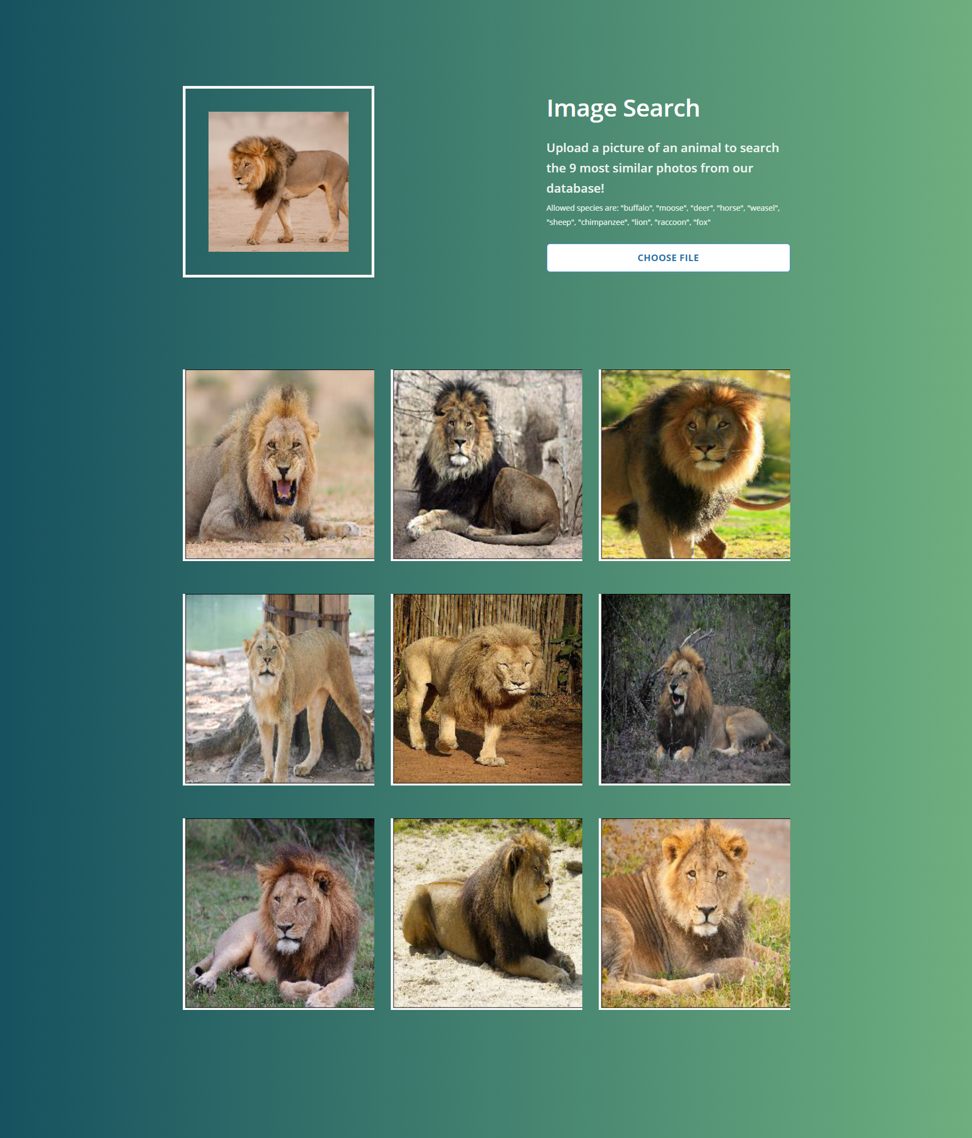
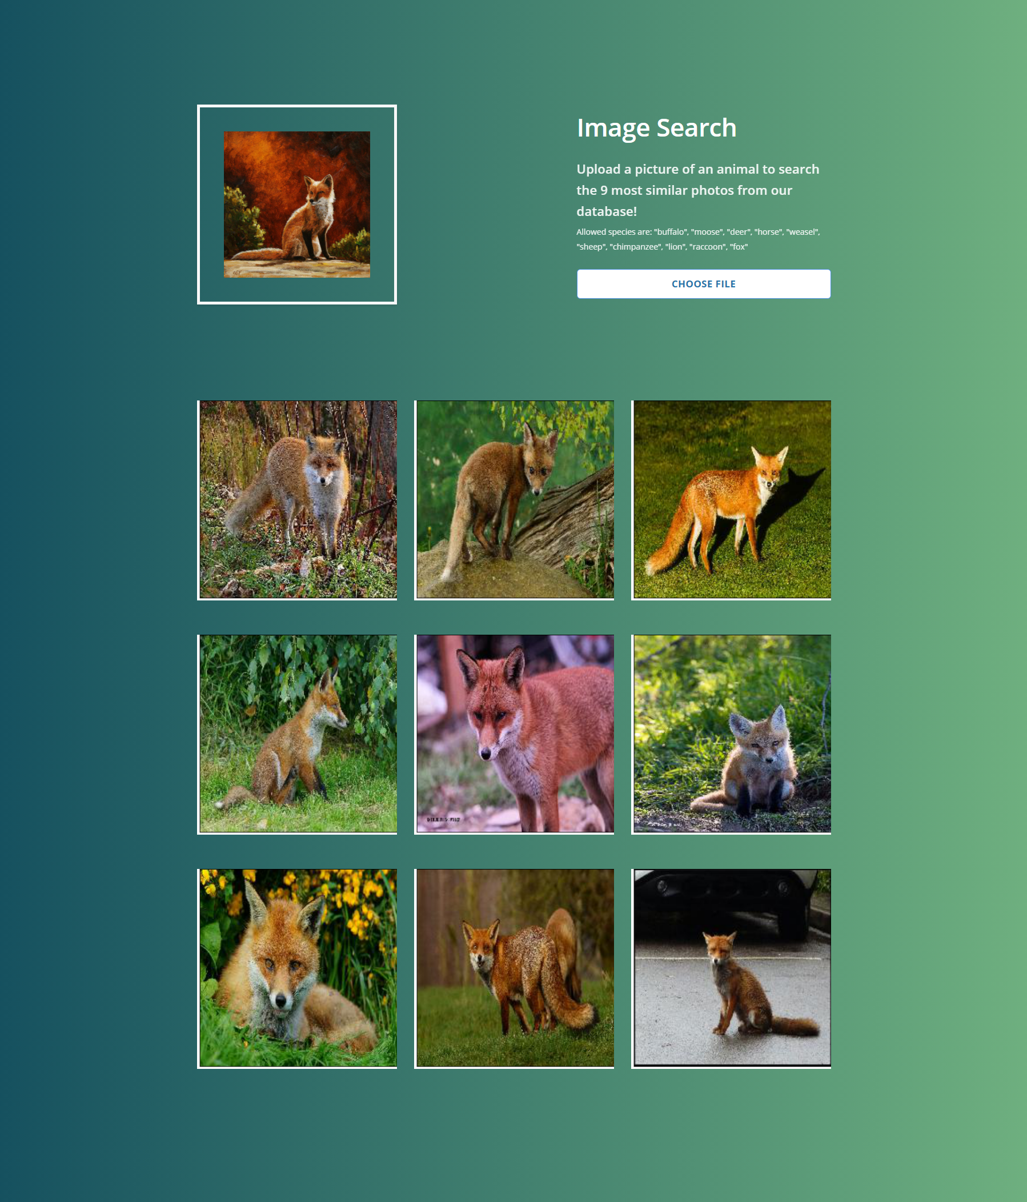
Results

Slide 15
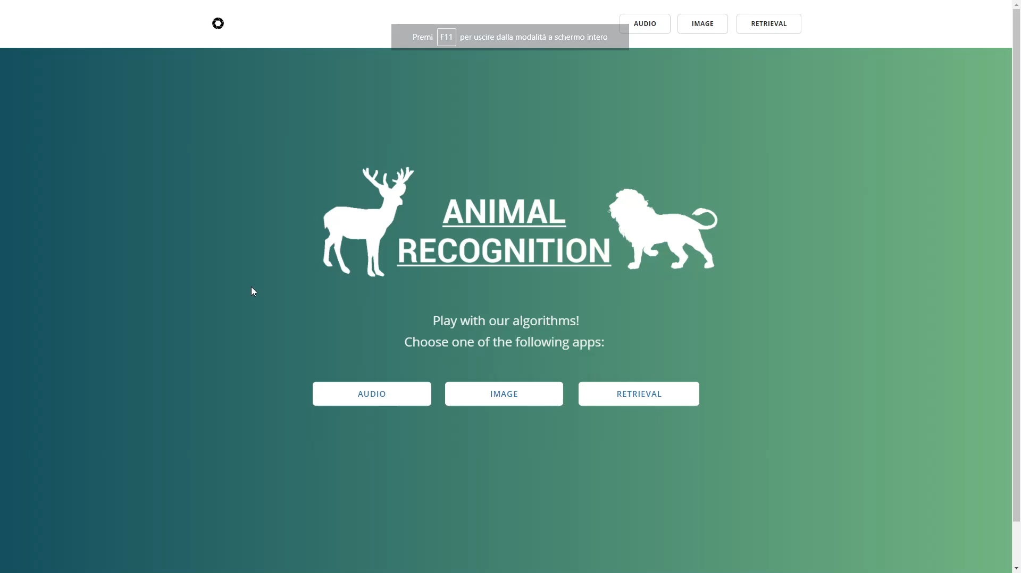
Demo

Slide 16
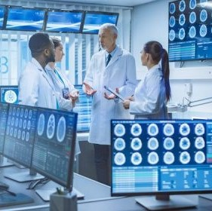
THANK YOU
Marco Peracchi- X
Federico De Servi - 812166

